Slide 1
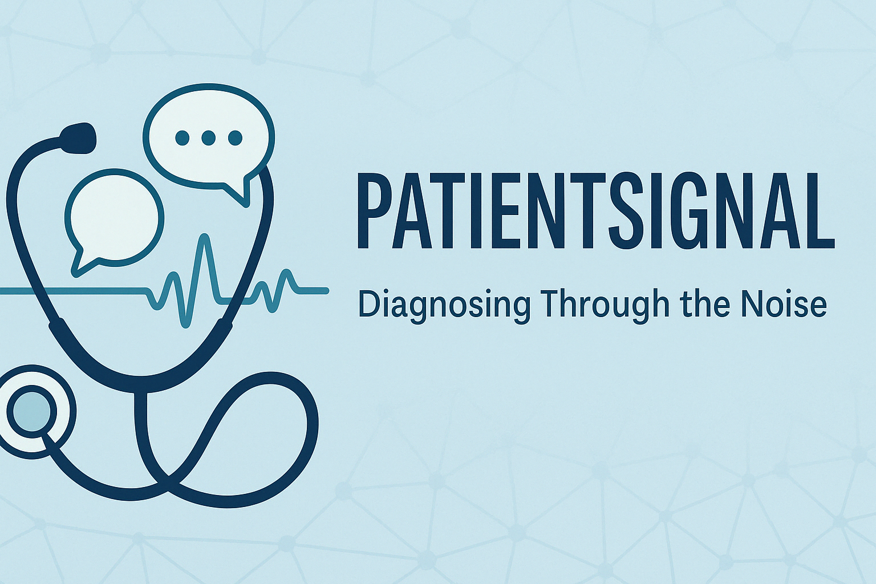
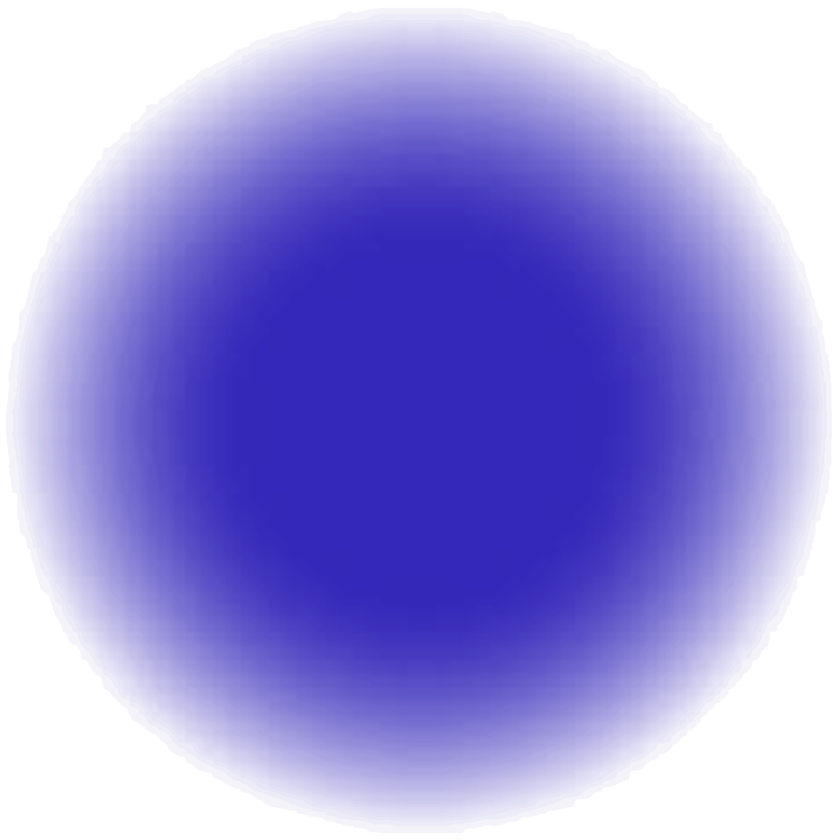
Group Members:
Eden Mama and
Liel Sheri

Slide 2

Project Description
In routine clinical interviews, physicians rely on patient's own words to describe their symptoms, but these descriptions often include unrelated details. In PatientSignal, we recreate this “natural noise” to clean symptom descriptions. Our aim is to measure how these conversational distractions affect diagnostic accuracy across different models.

Slide 3

Project Description
PatientSignal transforms patient's natural symptom descriptions into disease classifications, even when the descriptions include irrelevant or repetitive details. Our input consists of 1,200 clean symptom texts, which we re-generated using Llama3.1:8b to simulate two realistic noise levels: medium noise (80–220 words) and heavy noise (150–390 words). The models output one of 24 disease labels. We compare the accuracy of four classification methods: Multinomial Naïve Bayes, BERT, ClinicalBERT, and FLAN-T5 to identify the most robust model for handling conversational noise.
Prediction | Text | Version
Psoriasis | My skin is extremely sensitive and quickly irritated by changes in temperature or humidity. My nails have developed dents on them. I am worried about this sudden change. | Clean
Psoriasis | "Oh dear, my skin... it just gets so red and tender now. Can't even go outside without gettin' all irritated. Temperature changes, humidity... I swear, I'm like a leaf in the wind. Reminds me of that time at the beach when I was a youngin', got sunburned to a crisp on my poor face... (chuckles) Oh, where's my mind? Ah yes, the skin. And now these dents on my nails! Like little holes or somethin'. Never had that before. Started last month, maybe? Or was it two months ago? Time just gets away from you, doesn't it? Anyway... I'm worried about this. It's like my body's fallin' apart on me." | Medium Noise (80-220(
Psoriasis | Um, doc... (pauses) I've been having this... this trouble with my skin, you see. It's just so sensitive all of a sudden. Even when I'm out in the garden on a lovely day, and it's warm... (hesitates) oh dear, what was I saying? Ah yes, warm weather. My skin gets all red and irritated, like a rash or something. And then it starts to itch, terrible itching. Can't even wear my nice new scarf without breaking out in hives... (pauses again) And the nails! Goodness gracious, have you ever seen anything like this? Dents on my fingernails, all uneven and whatnot. It's as if... (stammers) I think it might be that time of year again, you know, when the pollen counts are high... (starts to digress) Did I tell you about the time I got a new cat, Whiskers? She was such a sweet thing, always purring on my lap... (trails off). Where was I? Ah yes, the nails. It's like they're trying to tell me something, but what, I don't know. And it started so suddenly! One day fine, next day... (pauses) Oh dear, I remember now: it happened after that big storm we had last month. Maybe it was something in the air? Or maybe it's just my imagination playing tricks on me... (chuckles nervously) I'm worried about this sudden change, doc... (hesitates again) If I can just get to the bottom of what's causing it all... (trails off into incoherent muttering) | Heavy Noise (150-390)

Slide 4
Previous works
“Deep learning models are not robust against noise in clinical text”, 2021 | DiagnoAI, 2022 | “Optimizing classifcation of diseases through language model analysis of symptoms”, 2024 | Source/Title
Named Entity Recognition (NER), Relation Extraction (RE), Textual Inference (TI), Semantic Similarity (SS) | Disease prediction from symptom descriptions | Disease prediction from symptom descriptions | Task solved
Fine-tuned transformer of ClinicalBERT, ClinicalXLNet, ClinicalELMo for each task. introduced controlled character and word-level perturbations and measured performance drops to assess robustness to noisy input. | Manually generated patient symptom based on symptom lists from Kaggle's dataset, Created 50 descriptions per disease. Fine-tuned all layers of pretrained BERT (TensorFlow) using SparseCategoricalCrossentropy and Adam optimizer. | Fine‑tuned BERT with Medical Concept Normalization, optimized separately with AdamP and AdamW and a Bidirectional LSTM model tuned via Hyperopt. | Approach/Model
EBM PICO clinical trial abstracts i2b2-2010 annotated patient reports MedNLI sentence pairs ClinicalSTS-2019 sentence pairs | Disease Symptom Prediction Dataset | Symptom2Disease | Data
NER: Entity-level F1, RE: Micro F1, TI: Accuracy, SS: Pearson correlation | Accuracy | Accuracy, Precision, Recall and F1-Score | Metrics
Clean (PPS=0): ClinicalBERT model with NER F1=73.61, RE F1=73.17, TI Accuracy=82.35, SS Pearson=83.71. ClinicalXLNet model with NER=77.68, RE=74.06, TI=85.12, SS=85.88. ClinicalELMo model with NER=69.44, RE=69.49, TI=78.51, SS=77.37. PPS=1 noise: Character-level drops of 4.14–8.87 points, word-level drops of 5.62–11.52 points across tasks, demonstrating high sensitivity even to small amounts of noise. | Validation Accuracy: 98.33% | MCN-BERT + AdamP: 99.58% Accuracy, 99.18% Precision, 99.28% Recall and 99.13% F1-Score. MCN-BERT + AdamW: 98.33% Accuracy, 98.39% Precision, 98.23% Recall and 98.18% F1-Score. BiLSTM + Hyperopt: 97.08% Accuracy, 97.37% Precision, 97.08% Recall and 97.05% F1-Score. | Results

Slide 5
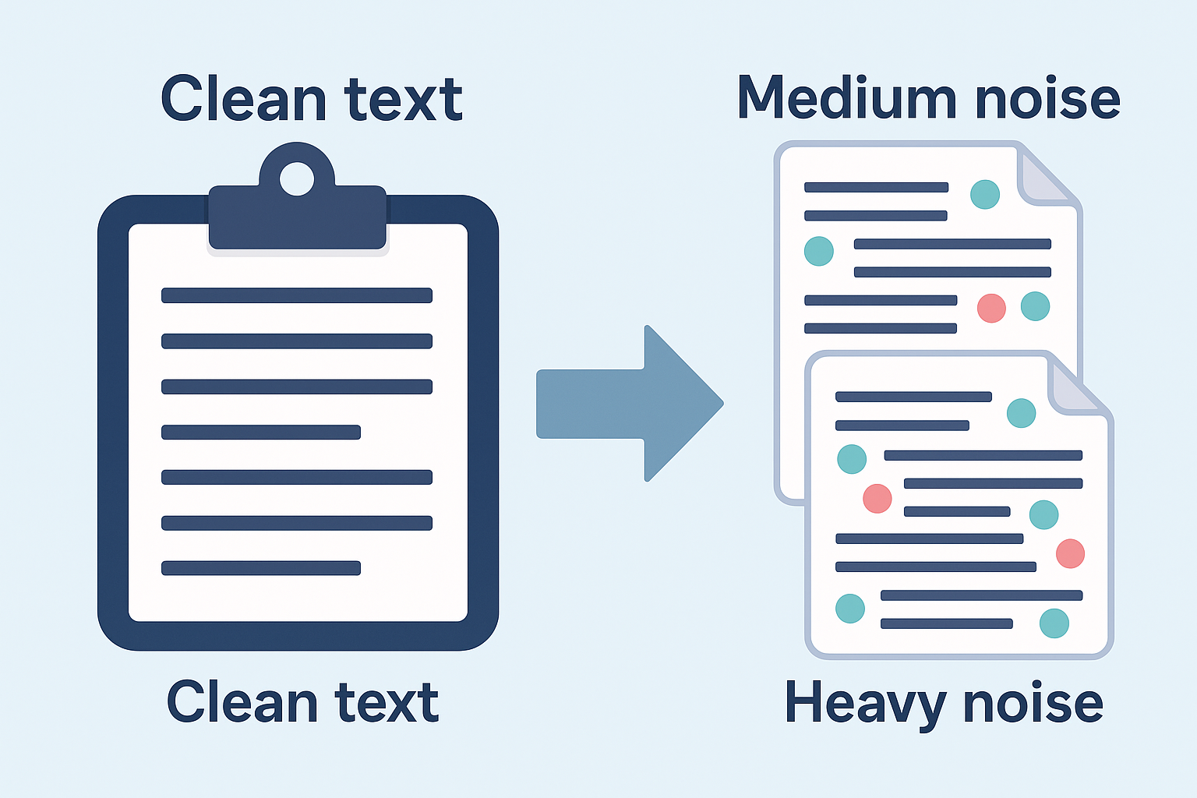
Data Preparation- From clean data to noise simulation
We used a Kaggle dataset with 1,200 clean symptom descriptions labeled into 24 diseases. Using Llama3.1:8b via Ollama, we generated two noisy versions: Medium noise (80–220 words) and Heavy noise (150–390 words). We checked for duplicates and missing values (none were found) . The final dataset contains 3,600 examples, balanced across labels.

Slide 6
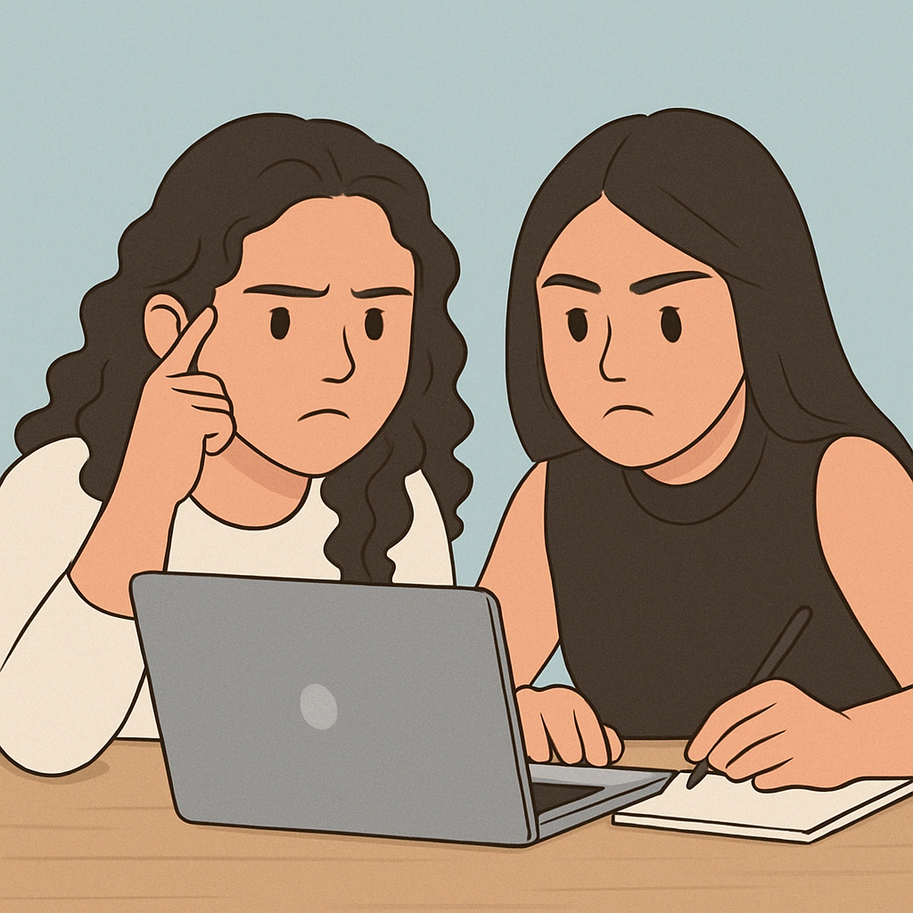
Models & Pipelines
We evaluated four models across three noise levels (Clean, Medium, Heavy), using an 80/20 train-test split:
Naïve Bayes: TF-IDF features
BERT (base): Fine-tuned with AdamP, freezing layers 0-3
ClinicalBERT: Fine-tuned with AdamP, freezing first 165 parameters + scheduler
FLAN-T5: Fine-tuned with Adafactor, using tokenized text-to-label format
Each model was trained separately per noise level, with adjusted epoch counts.

Slide 7

Metric
We used Accuracy as the primary evaluation metric across all models and noise levels. This allowed us to assess how each model handles increasing noise while maintaining correct disease classification.

Slide 8
Code Organization
GitHub Repository: PatientSignal GitHub
Data Files:
Train_data.csv
Train_data_with_noise2.csv
Main Code Files & Functions:
Data Generation (Noise Creation): Noise_Generation.ipynb
Function: generate_patient_noise(text, level)
Data Preparation & Model Training:
PatientSignal.ipynb (Naïve Bayes, BERT, ClinicalBERT, FLAN-T5)
Pipeline Overview: Original Data → Noise Generation → Train/Test Split → Training → Results Visualization

Slide 9
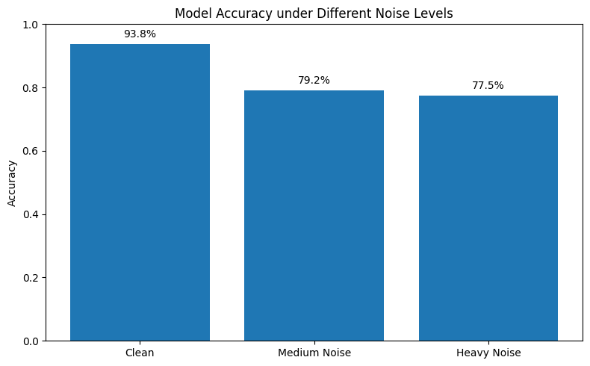
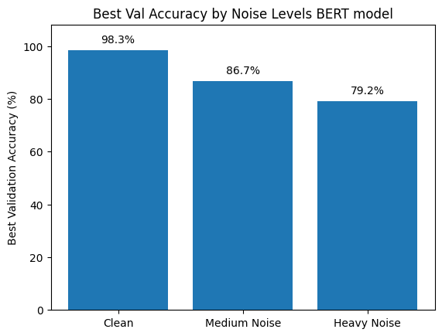
Model's Results
Multinomial Naïve Bayes Model:
Clean data accuracy: 93.8%
Medium noise accuracy: 79.2%
Heavy noise accuracy: 77.5%
BERT Model:
Clean data accuracy: 98.3%
Medium noise accuracy: 86.7%
Heavy noise accuracy: 79.2%

Slide 10
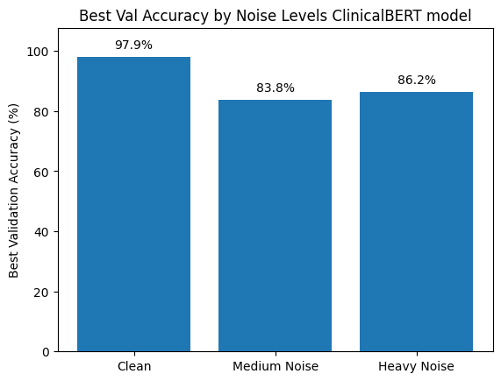
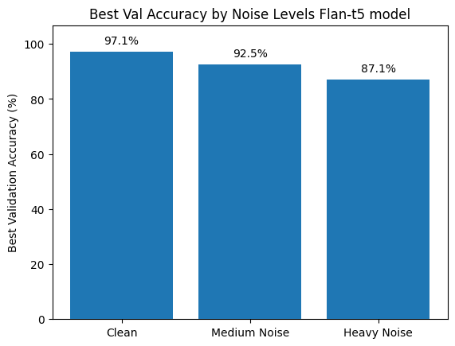
Clinical BERT Model:
Clean data accuracy: 97.9%
Medium noise accuracy: 83.8%
Heavy noise accuracy: 86.2%
Flan T-5 Model:
Clean data accuracy: 97.1%
Medium noise accuracy: 92.5%
Heavy noise accuracy: 87.1%

Slide 11

Main Results and conclusion
Model Performance (Accuracy)
Heavy Noise | Medium Noise | Clean | Model
77.5% | 79.2% | 93.8% | Naïve Bayes (Baseline)
79.2% | 86.7% | 98.3% | BERT
86.2% | 83.8% | 97.9% | ClinicalBERT
87.1% | 92.5% | 97.1% | FLAN-T5
Insights from Data:
Noise Effect: Accuracy drops with noise.
Clinical Bert anomaly: After a sharp drop in moderate noise (83.8%), its accuracy increases to 86.2% under heavy noise (a possible reason for this is the repetition of clinical terms in longer, noisier texts).
Model Comparison: Naïve Bayes, as a baseline with no deep language understanding, showed the sharpest decline under noise, while BERT led on clean data and was overtaken by ClinicalBERT and FLAN-T5 as noise increased, with FLAN-T5 achieving the best overall accuracy under noisy conditions.
These results highlight the importance of choosing the right model for complex medical tasks, as well as to invest in designing training methods

Slide 12
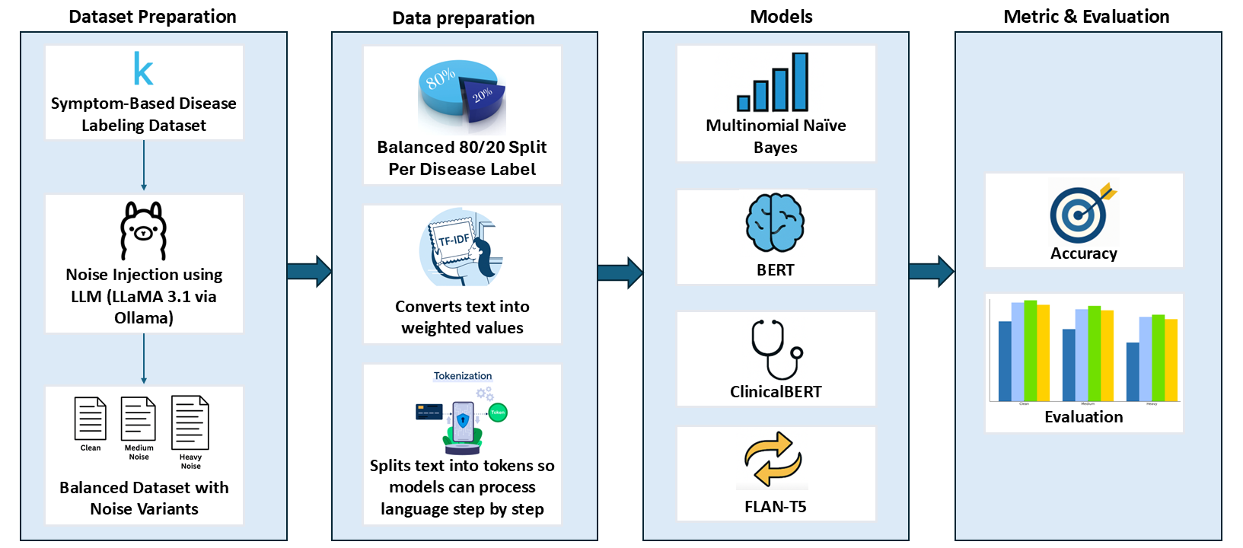
Visual Abstract

Slide 13


Thank you!

